Slide 1
IBM Cloud IAM: Secure Access Control for Cloud Object Storage (COS)
Presented By-
Fatima Anab

Slide 2

What is this project about?
This project teaches you how to control who can access your data stored in IBM Cloud Object Storage (COS) by using IBM Cloud IAM (Identity and Access Management).
You will learn how to create a storage space in the cloud, keep the data safe using encryption, and set rules for who can view or change the data. You’ll create users and service IDs, and assign them roles like Viewer, Editor, or Administrator to manage what they can do. The project also covers how to let cloud services talk to each other safely using service-to-service authorization. Overall, this lab helps you understand how to store data securely and control access in a cloud environment, using simple and practical steps.

Slide 3
Tools and Technologies
IBM Cloud platform
IAM Module (GUI based)
IAM Users, Access groups
Cloud Object Storage
No code interface
PowerPoint/ word for documentation

Slide 4
What You Will Learn?
.
How to create cloud storage
How to control who can access what
How to keep your data safe
2

Slide 5
Key concepts of IAM
Users: People who access IBM Cloud (via IBM IDs or service IDs)
Access Groups: Grouping of users for common permissions
Policies: Define what users or groups can do
Roles: Permissions levels (Viewer, Editor, Administrator, etc.)
Resources: IBM Cloud services

Slide 6
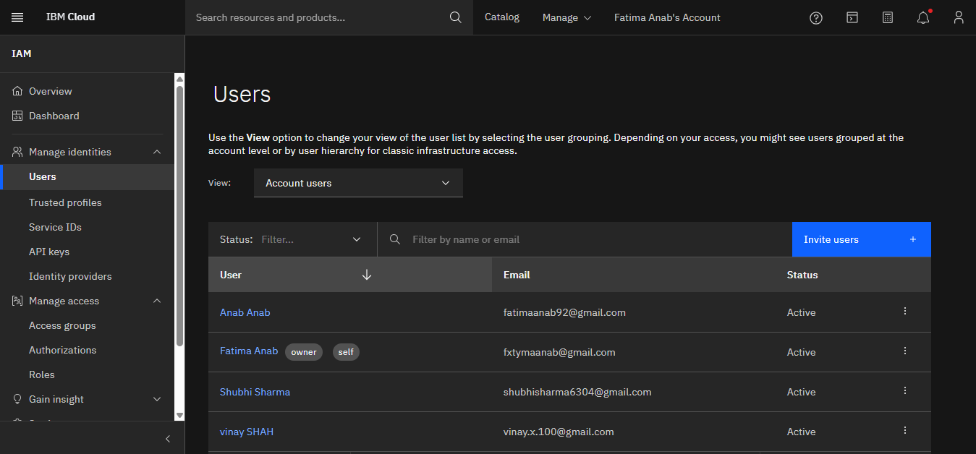
Inviting Users

Slide 7
Access Groups
Combine users with the same permissions
Easier to manage access at scale
Assign one policy to many users at once

Slide 8
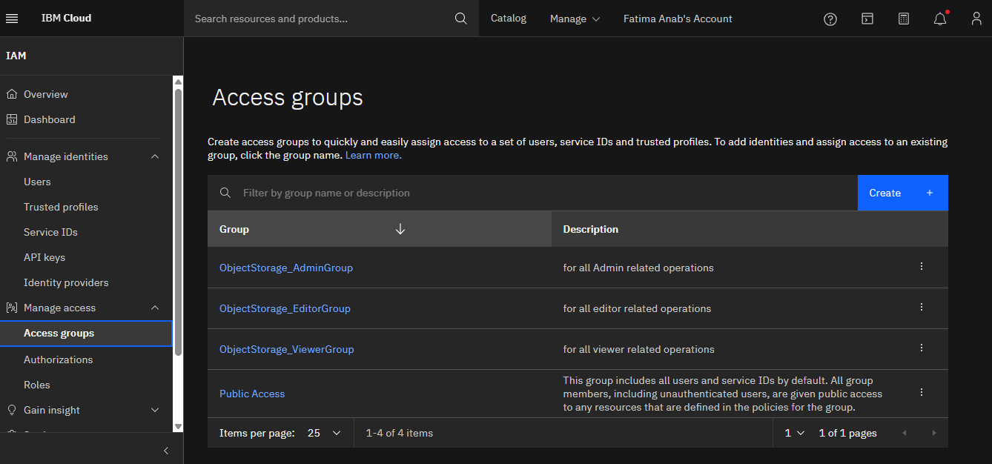

Slide 9
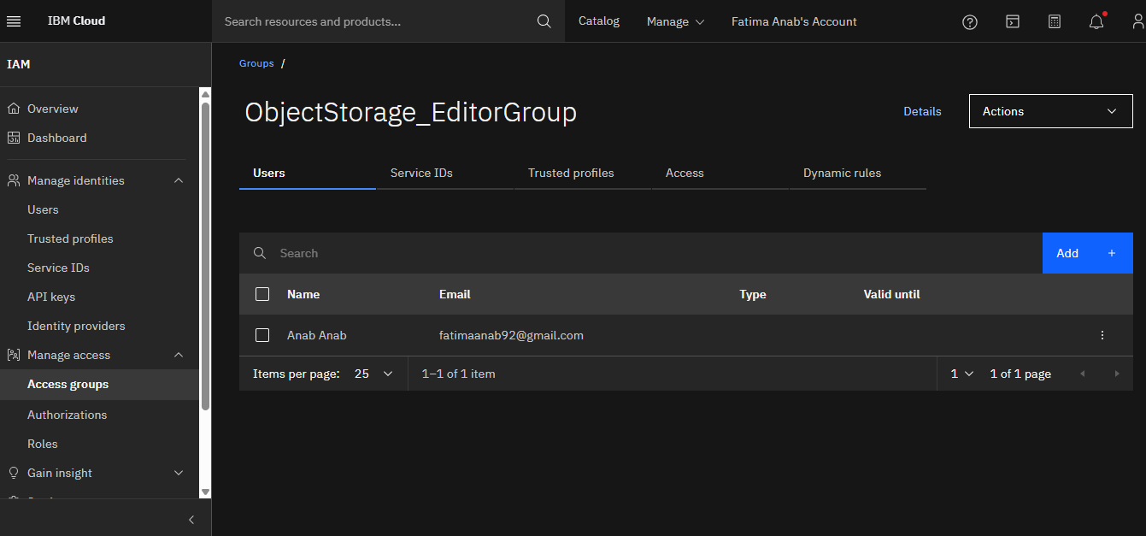
Creating Access Group

Slide 10
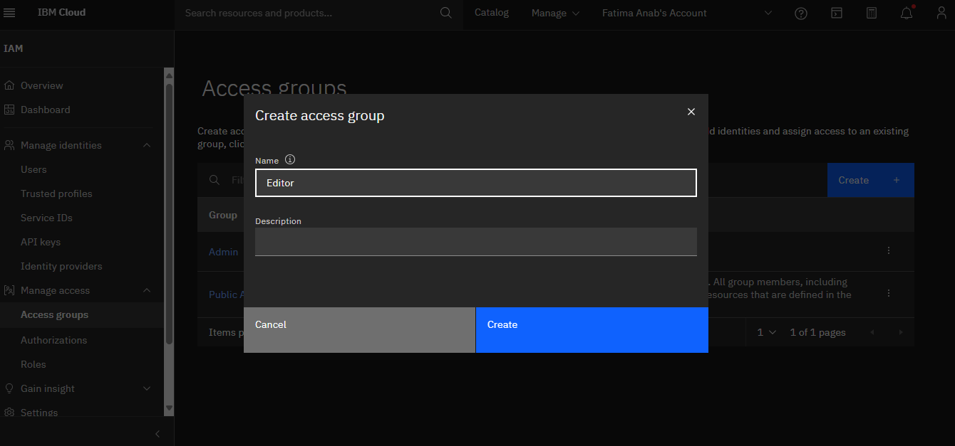

Slide 11
IAM roles
Viewer: Read-only access
Editor: Read & write access
Administrator: Full access + user management
Manager: Control IAM for specific service

Slide 12
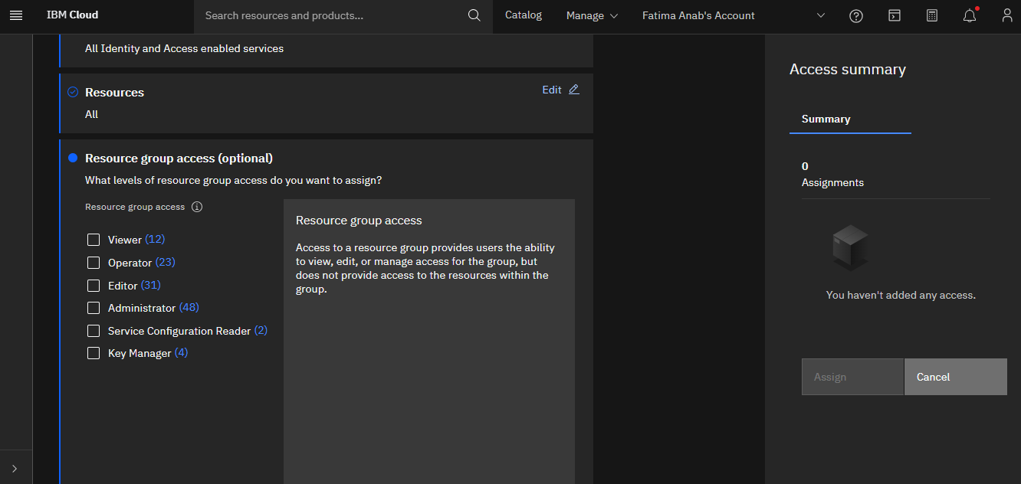

Slide 13
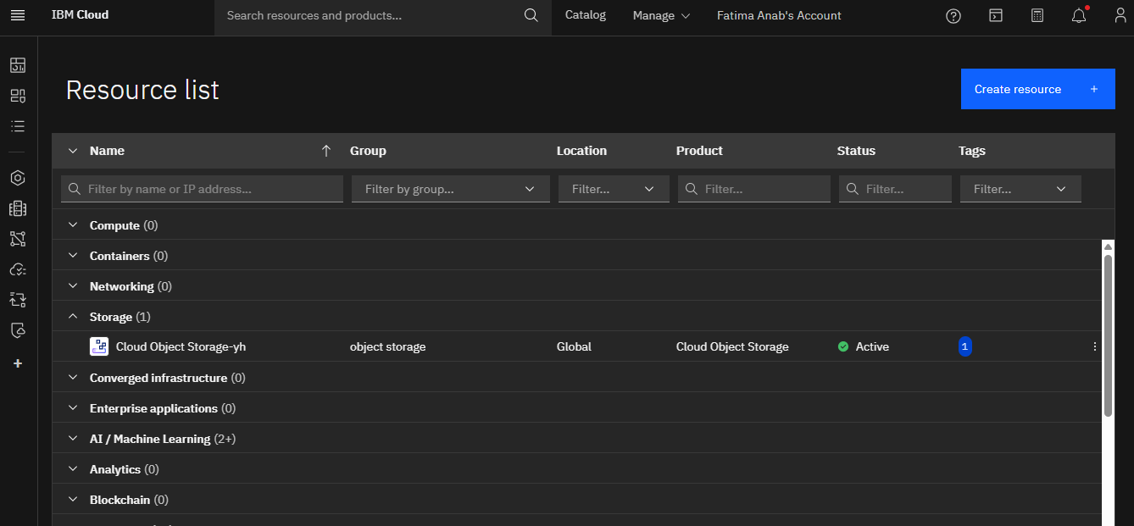
Creating a COS
We created a Cloud Object Storage (COS) instance from the IBM Cloud console.
After successful creation, the COS instance is now visible in the Resource List.

Slide 14
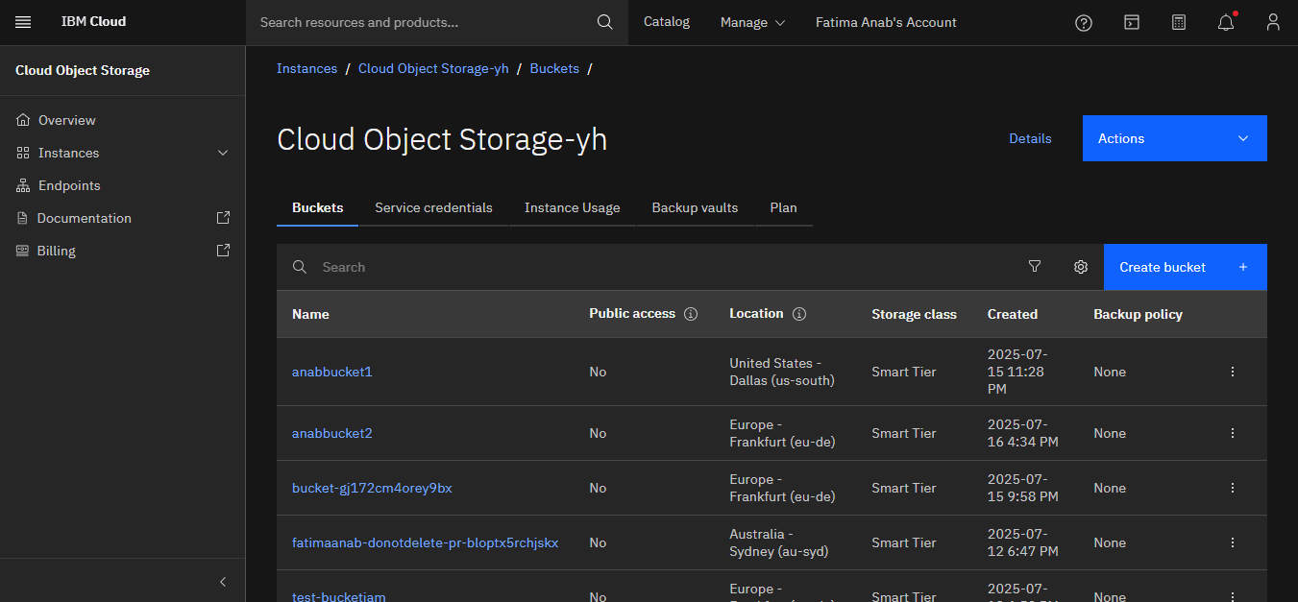
Buckets in COS
Buckets in Cloud Object Storage (COS) are containers used to organize, store, and manage objects (files) within a COS instance.

Slide 15
Testing IAM Roles: Viewer, Writer, Administrator
Viewer role was tested by verifying read-only access to the COS buckets and objects.
Writer role was able to upload, modify, and delete objects, but not manage settings.
Administrator role had full access, including managing service settings, buckets, and IAM policies.

Slide 16
Summary
IAM helps you secure your IBM Cloud account
Users and Services get only the access they need
Policies and roles control permissions
Use access groups and service IDs smartly

Slide 17
Thank you
for listening!

